Slide 1
Quality Improvement
“If you can’t describe what you are doing as a process, you don’t know what you are doing”
W. Edwards Demming

Slide 2
Words of Wisdom from Deming
Plan: “Those who fail to plan are planning to fail.”
Do: “The road to Hell is paved with good intentions.”
Study: “Many people fail at this point. They set a plan and begin the work, but never check to see if the plan is moving them in the right direction.”
Act: “After checking your results and identifying areas for improvement, the next step is to make the necessary adjustments.

Slide 3
What is Quality?
“Quality is a never ending cycle of continuous improvement” W. Edwards Deming
“The degree to which health services for individuals and populations increase the likelihood of desired health outcomes are consistent with current professional knowledge.” Institute of Medicine (IOM) 1996

Slide 4
Seven Aims of High Quality Health Care System (IOM 2001)
Safe – avoiding injuries to patients from the care that is supposed to help them.
Effective – providing services based on scientific knowledge to all who could benefit and refraining from providing services to those not likely to benefit (avoiding underuse and overuse).
Patient-centered – providing care that is respectful of and responsive to individual patient preferences, needs, and values and ensuring that patient values guide all clinical decisions.
Timely – reducing waits and sometimes harmful delays for both those who receive and those who give care.
Efficient – avoiding waste, in particular waste of equipment, supplies, ideas, and energy.
Equitable – providing care that does not vary in quality because of personal characteristics, such as gender, ethnicity, geographic location, and socioeconomic status.
Evaluating the Quality of Health care: www.eresource.org

Slide 5
Measures of Quality
Structure Measures
  characteristics of the setting in which care takes place. Measures of the setting used might include characteristics of:
    Physicians and hospitals (e.g., a physician's specialty or the ownership of a hospital);
    Personnel; and/or
    Policies related to care delivery.
Process Measures
  Assess whether a patient received what is known to be good care. They can refer to anything that is done as part of the encounter between a health care professional and a patient, including interpersonal processes, such as providing information and emotional support, as well as involving patients in decisions in a way that is consistent with their preferences,
Outcome Measures
  Refer to a patient's health status or change in health status resulting from the care received. This includes intended outcomes, such as the relief of pain and unintended outcomes, such as complications.

Slide 6
Three Fundamental Questions
Setting Aims: What are we trying to accomplish?
  Improvement requires setting aims.
  The aim should be time-specific and measurable
  define the specific population of patients that will be affected.
Establishing Measures: How will we know that a change is an improvement?
  Feedback is a critical part of testing and implementing changes
  measures tell a team whether the changes they are making actually lead to improvement.
Selecting Changes: What changes can we make that will result in improvement?
  All improvement requires making changes
  Not all changes result in improvement.
  Organizations must identify the changes that are most likely to result in improvement.
Notes:
A team’s aim statement should include:
What is expected to happen
A timeframe
The system to be improved
The setting or sub-population of patients
Goals
(For some teams) Guidance for the activities such as strategies for the effort and limitations

Slide 7
Leading Quality Improvement: Essentials for Managers
Manage self & your time
Effectively manage people
Manage Down
Manage Up
Build the skills and capabilities to lead quality improvement efforts at the middle manager level of the organization
Manage your peers
Develop and tend to culture
Effectively manage a department or team
Understand & manage systems
Create effective processes
Execute effectively on admin processes
Partner with patients & families
Build will for change
Effectively manage improvement
Identify & spread good ideas & practice
Execute improvement
Sustain the gains

Slide 8
Four Steps to Quality
STEP 1: IDENTIFY OUTCOMES
Define what you want to improve
Develop measures
How will I know when I get there?
STEP 2: ANALYZE CURRENT PROCESS
Identify actual sequence of events involved in the process
Look at waste, duplication, time,
and distance involved
Consider the process from the
patient’s / customer’s perspective
STEP 3: GENERATE CHANGE IDEAS
Where do we get change ideas?
Research – Standards – Key Aspects
of Care
Lectures from experts
Collaboration with other teams
Other networking such as
STEP 4: PILOT
Plan – Who? What? When?
Do – Assign tasks
Study – results against established
Outcomes
Act – Continue improvement process
where needed
Notes:
Areas to address
Functional status
Satisfaction
Total costs/productivity
Clinical process & outcomes

Slide 10
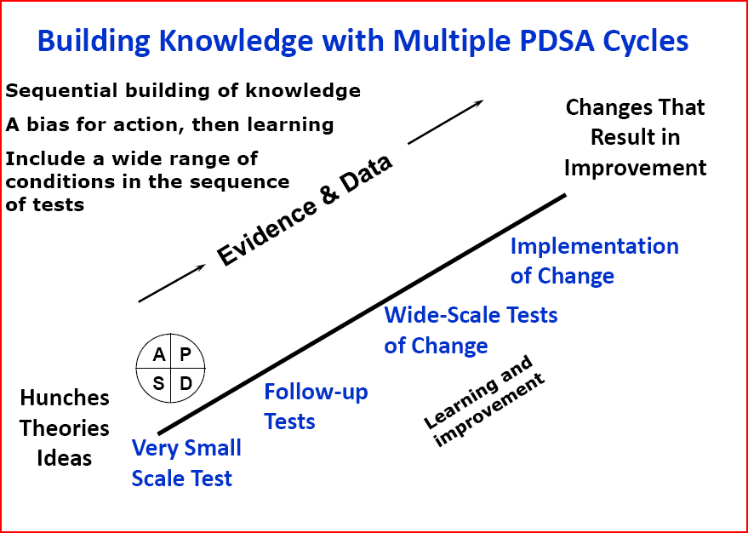
Notes:
Plan-Do-Study-Act (PDSA)
Cycle to test and implement changes in real work settings.
PDSA cycle guides the test of a change to determine if the change is an improvement.
When ideas have been tested, adapted, and shown to work, the PDSA cycle is used to implement the change
Hardwire change into practice
The Plan-Do-Study-Act (PDSA) cycle provides a procedure for testing a change in the real work setting – by planning it, trying it, observing the results, and acting on what is learned. This is the scientific method used for action-oriented learning.

Slide 11
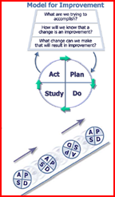
Why this model for improvement?
Useful for both process, service, and performance improvement
Applicable in all types of organizations
Applicable to all groups and levels in an organization
Facilitates the role of teamwork in improvements
Provides a framework for application of improvement tools and methods
Emphasizes and encourages the iterative learning process
Provides a way to empower people in the organization to take action.

Slide 12
CLINICAL OUTCOME
Reduce facility Acquired
Pressure Ulcers
to 0%
annual rate
Process
Use Braden skin
assessment
tool every 24hrs
Process
Perform skin risk
assessment on
admission and daily
Tests
of change
Process
Care plan for skin risk
if Braden < 18
New Process
Test of Change
Implement a turn team
to ensure every 2 hour turning
Process
Care plan for pressure
ulcer
If present
Notes:
Example of a continuous improvement process related to preventing pressure ulcers.

